Slide 1

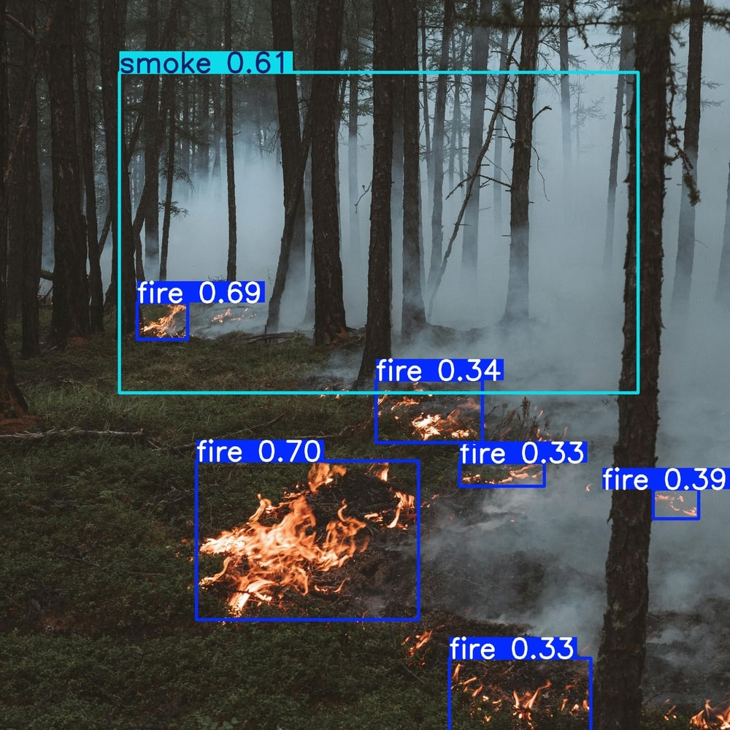

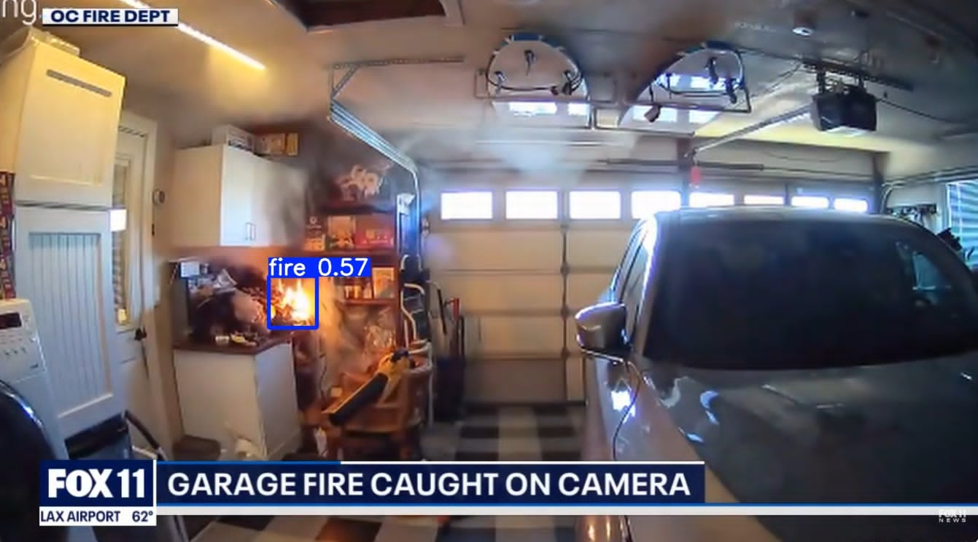
CSE 468 · Computer Vision · Section 01 · Group 07
Fire &
Smoke
Detection
Real-Time Visual Hazard Detection using YOLOv8s & YOLOv8n
Khatune Jannat · 2131916642
Mahdin Muhammad Jakir · 2232411042
North South University · Dhaka, Bangladesh · May 2026

Slide 2




Problem Statement
The Problem
Why Traditional Methods Fail
1
Expensive and Resource-Intensive Systems
Ionisation sensors
Conventional fire detection systems depend on costly sensors and infrastructure, limiting accessibility in many regions.
Proximity-dependent — useless if fire starts far from sensor
2
Billions in damage
CCTV infrastructure
Industrial & wildfire disasters destroy infrastructure worth billions every year
Massively underutilised — cameras exist but nobody watches 24/7
3
Delayed sensor response
Manual monitoring
Traditional heat/smoke sensors react ONLY after fire is already widespread
Infeasible at scale — human attention lapses, costs skyrocket
4
High false-alarm rates
No visual context
Dust, steam, and cooking vapour constantly trigger false alarms in sensor systems
Sensors give no spatial info — responders can't locate the hazard

Slide 3



Our Solution — Optical Camera-Based Fire & Smoke Detector
Deploy optical cameras on existing CCTV infrastructure + YOLOv8 deep learning to detect fire & smoke in real-time with bounding-box precision.
Optical Camera Input
Real-Time Detection
YOLOv8 Deep Learning
Instant Alert System
Standard RGB CCTV feed
~14 ms per frame
Trained on 45,252 images
Auto-trigger on detection
Live bounding-box output
No special hardware needed
2 classes: Fire & Smoke
CCTV integration ready
Quantization for edge devices
(future works)
81.8% mAP@0.5

Slide 4




Methodology Pipeline
01
02
03
04
Data Collection
Data Preprocessing
Model Hypertuning
Model Training
D-Fire (20K)
Class remapping
YOLOv8n vs YOLOv8s
COCO pretrained init
Indoor Fire (8K)
Collision-free naming
Epoch sweep: 45
736x736 px input
Flame-BD (2K)
70/20/10 split
Batch size: 32
CIoU + DFL loss
Iron Wolf (15K)
Linear lr: 0.01
Train on google-colab t4 GPU
45,252 total images
MuSGD momentum 0.937
45 epochs converge

Slide 5
Methodology — Model Hypertuning Details
Training Hyperparameters
YOLOv8n vs YOLOv8s — Why YOLOv8s?
Model
YOLOv8s (11.1M params)
Property
YOLOv8n
YOLOv8s
Epochs
45
Parameters
3.2M
11.1M
GFLOPs
8.7
28.6
Input Size
736x736px
mAP50 (COCO)
37.3%
44.9%
Optimizer
MuSGD (momentum = 0.937)
Inference (GPU)
1.5ms
2.2ms
Learning Rate
0.01 → 0.0001 (cosine)
Composite Loss Function
Batch Size
32
L = L_cls + λ₁·L_box + λ₂·L_dfl
Weight Decay
0.0005
L_cls
Binary cross-entropy for fire/smoke classification
Pre-training
MS-COCO weights
L_box
CIoU regression — penalises overlap + centre distance
Augmentation
Mosaic, H-flip, HSV, Scale
L_dfl
Distribution Focal Loss for precise box boundary

Slide 6
Model Metrics — YOLOv8s (Small/Our Primary Model)
YOLOv8s
81.8%
81.6%
74.8%
mAP@0.5
Precision
Recall
All classes
Fire+Smoke
Fire+Smoke
)
YOLOv8n
80.0%
81.3%
71.8%
mAP@0.5
Precision
Recall
Fire+Smoke
Fire+Smoke
All classes
)

Slide 7
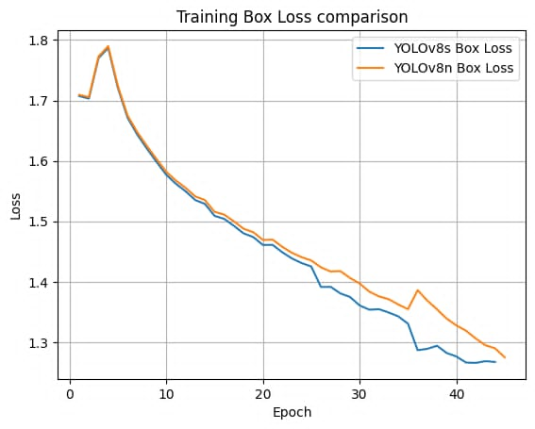
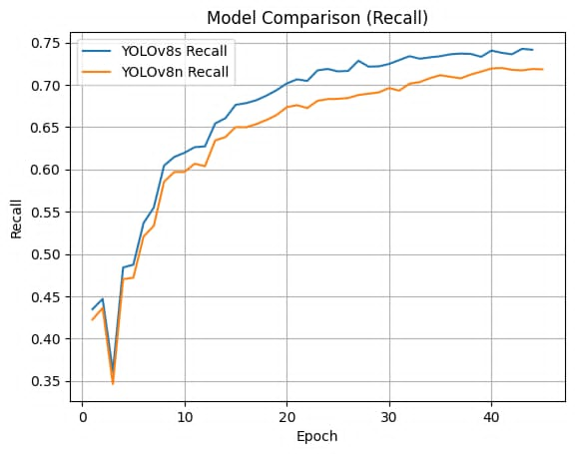
Model Comparison — YOLOv8n vs YOLOv8s
YOLOv8n — Nano
YOLOv8s — Small
VS

Slide 8
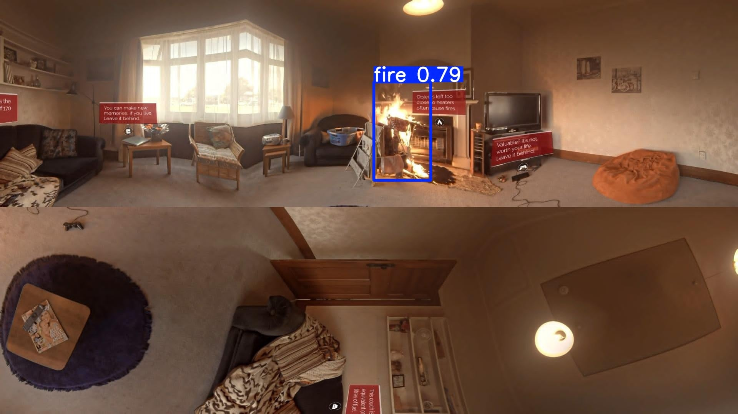
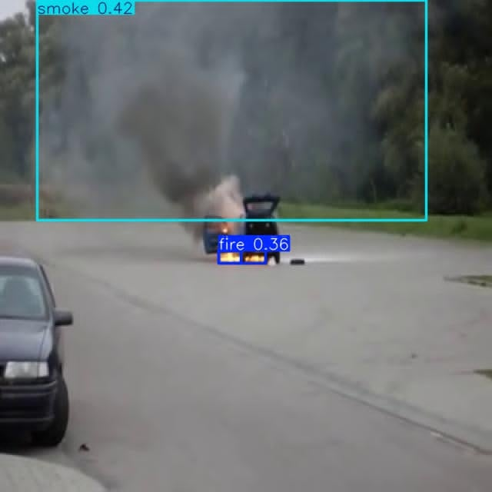
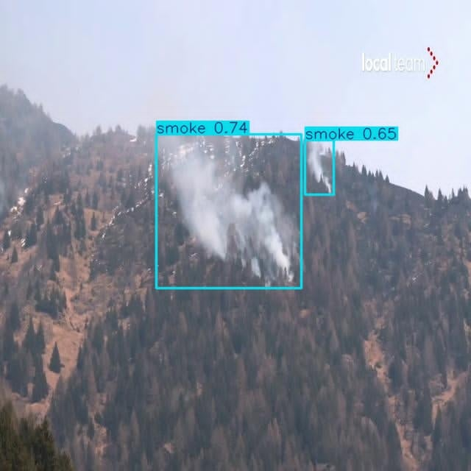

Model Inference — YOLOv8s Detection Results
Urban Building Fire
Forest / Wildfire Smoke
Industrial Vehicle Fire
FIRE 0.79
SMOKE 0.74, 0.65
FIRE 0.36 + SMOKE 0.42
Indoor / Residential
UAV Aerial View
Outdoor / Road Scene

Slide 9





Conclusion & Future Works
Conclusion
Future Works
YOLOv8s achieves ~81.8% mAP@0.5 across fire & smoke
RGB fusion
Night-time & low-light scenes using infrared cameras
45,252-image multi-source corpus is the largest used in this class of detectors
Edge deployment (QAT)
Jetson Nano / Raspberry Pi via Quantisation-Aware Training
Data-centric merging (4 sources) alone narrows the gap to modified architectures
More smoke datasets
Further improve smoke detection
Real-time capable: ~14 ms/frame, 30+ FPS — suitable for live CCTV deployment
Expand detection classes
Explosion, gas leak, person-in-danger multi-class
Plug-and-play with existing optical cameras — no hardware upgrade required
Online temporal modelling
LSTM over optical flow to suppress false alarms from glare

Slide 10
Thank You
CSE468 · Computer Vision · Section 01 · Group 07
Khatune Jannat · 2131916642
Mahdin Muhammad Jakir · 2232411042

